Slide 1




DIGITAL MARKETING ASSIGNMENT
Email Marketing
Meenakshi Mali
BCA - 3rd Semester
Session 2025-2028

Slide 2

Digital Marketing
Assignment Report
ASSIGNMENT FOLIO
Assignment Folio of
Digital Marketing
Submitted to
Dezyne École College
Toward Digital Marketing
By
BCA
3rd Semester
Meenakshi Mali
Dezyne École College
106/10, Civil Lines, Ajmer
www.dezyneecole.com
2026-2028

Slide 3
Digital Marketing
Case Study
ASSIGNMENT FOLIO
We take this opportunity to express our sincere gratitude to Dezyne École College for providing us with the knowledge, resources, and guidance essential to the successful completion of this project.
Our deepest thanks to our respected Principal, Dr. Vinita Mathur, for her visionary leadership and continuous encouragement. Her commitment to academic excellence and student growth has been a constant source of motivation and pride.
We are equally thankful to all our faculty members for their consistent support, expert advice, and valuable insights that shaped our learning and helped us achieve this milestone.
Lastly, we extend heartfelt thanks to everyone who directly or indirectly contributed to the success of this project.
We are proud to be part of Dezyne École College, an institution that truly nurtures professionalism, innovation, and purpose.
With sincere appreciation,
Meenakshi Mali
Department of BCA
Dezyne École College, Ajmer

Slide 4
Digital Marketing
Case Study
ASSIGNMENT FOLIO
Objective:
Build Subscriber Base, Increase Engagement, Promote Products, Improve Conversions & Maximize ROI
1. Subscriber List Creation
Created audience list in Mailchimp. Segmented subscribers based on interests and demographics.
2. Email Campaign Setup
Selected regular email campaign and defined campaign name, audience, and subject line with strong CTA.
3. Email Designing
Designed responsive email using drag-and-drop builder. Added logo, banner image, product details, and clear Call-to-Action buttons.
4. Test Email & Optimization
Sent test emails to check layout, links, subject line, and mobile responsiveness.
5. Final Publication & Performance Tracking
Scheduled and sent final campaign. Monitored open rate, click-through rate (CTR), and conversions.

Slide 5

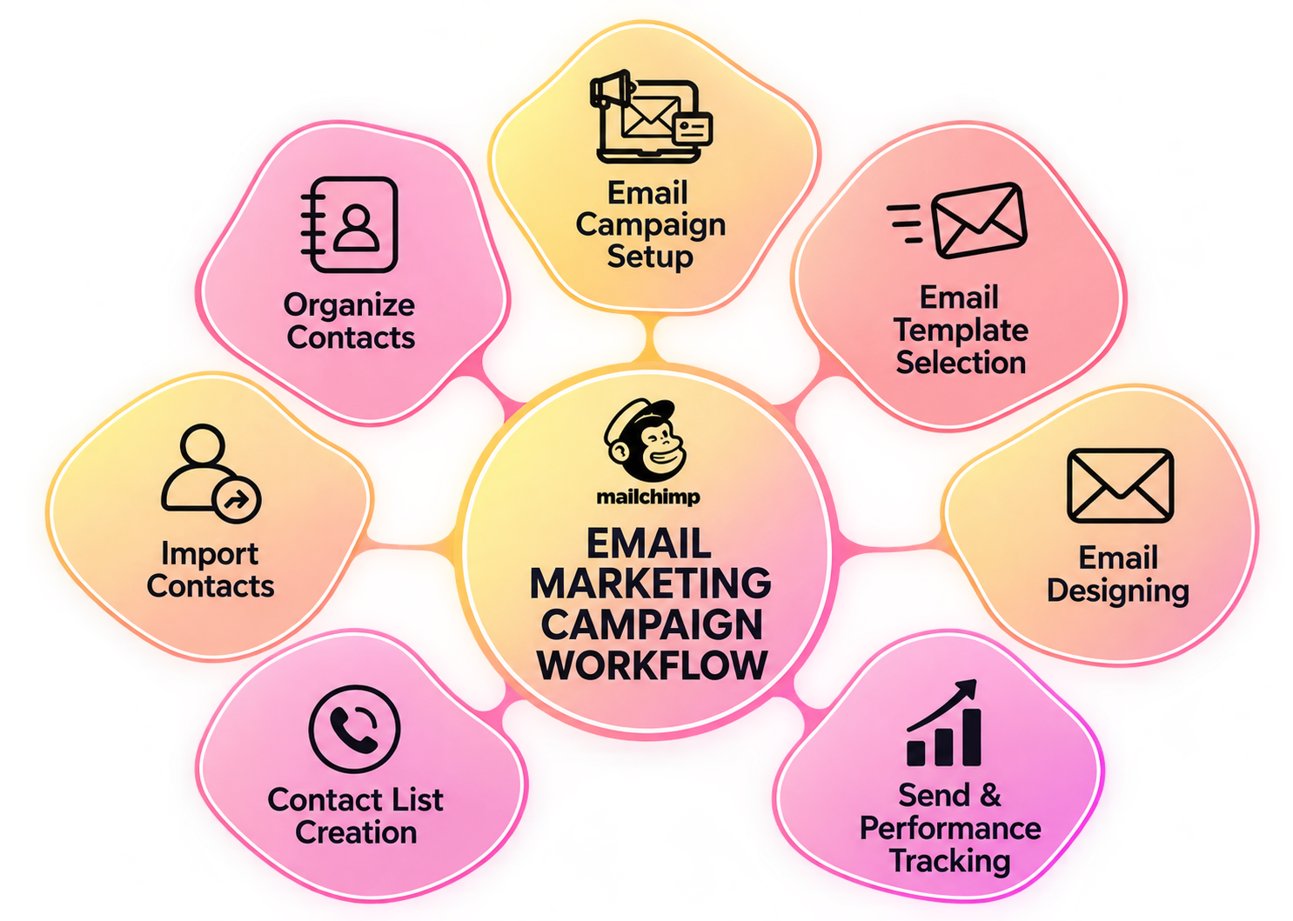

Slide 6

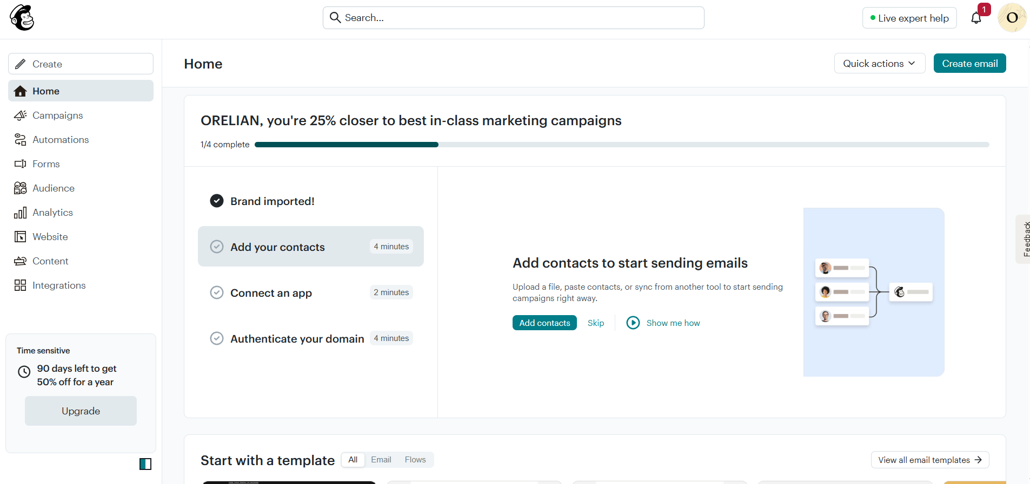
Mailchimp Account Setup

Slide 7
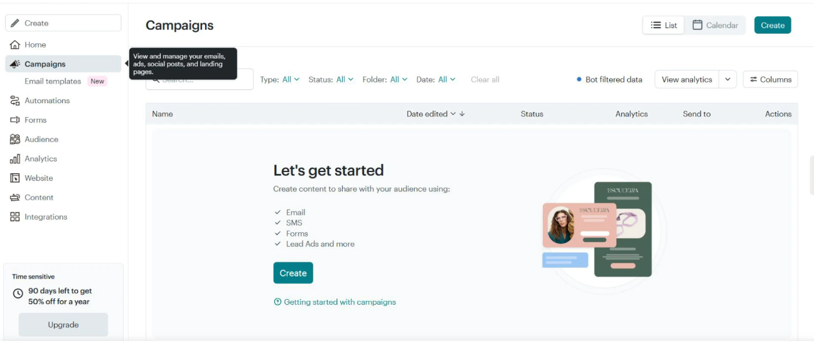
Email Campaign Dashboard

Slide 8
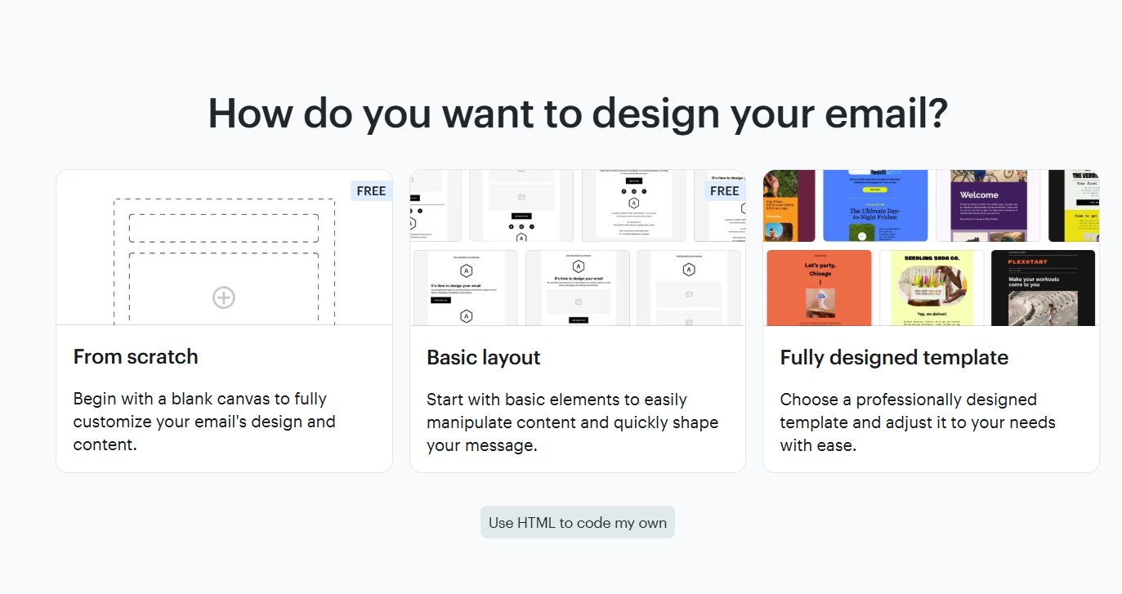
Email Design Method Selection

Slide 9
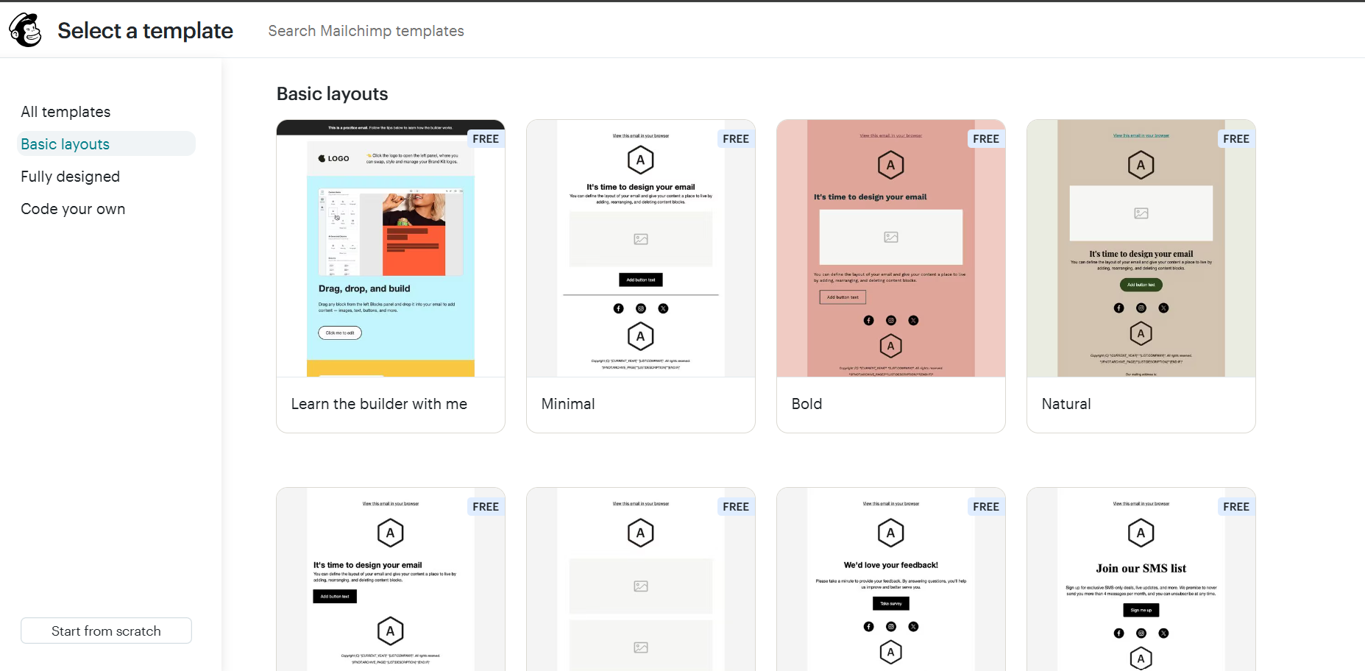
Email Template Selection

Slide 10
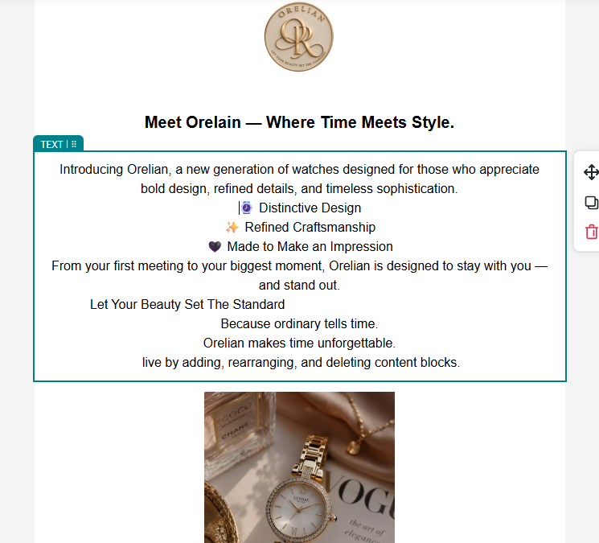
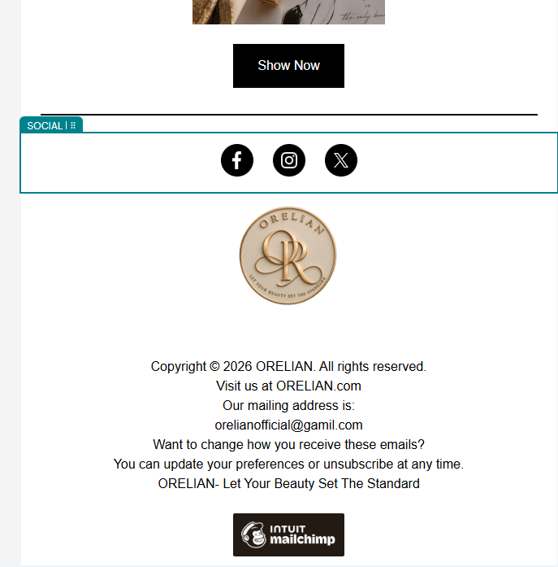
Email Design & Customization

Slide 11
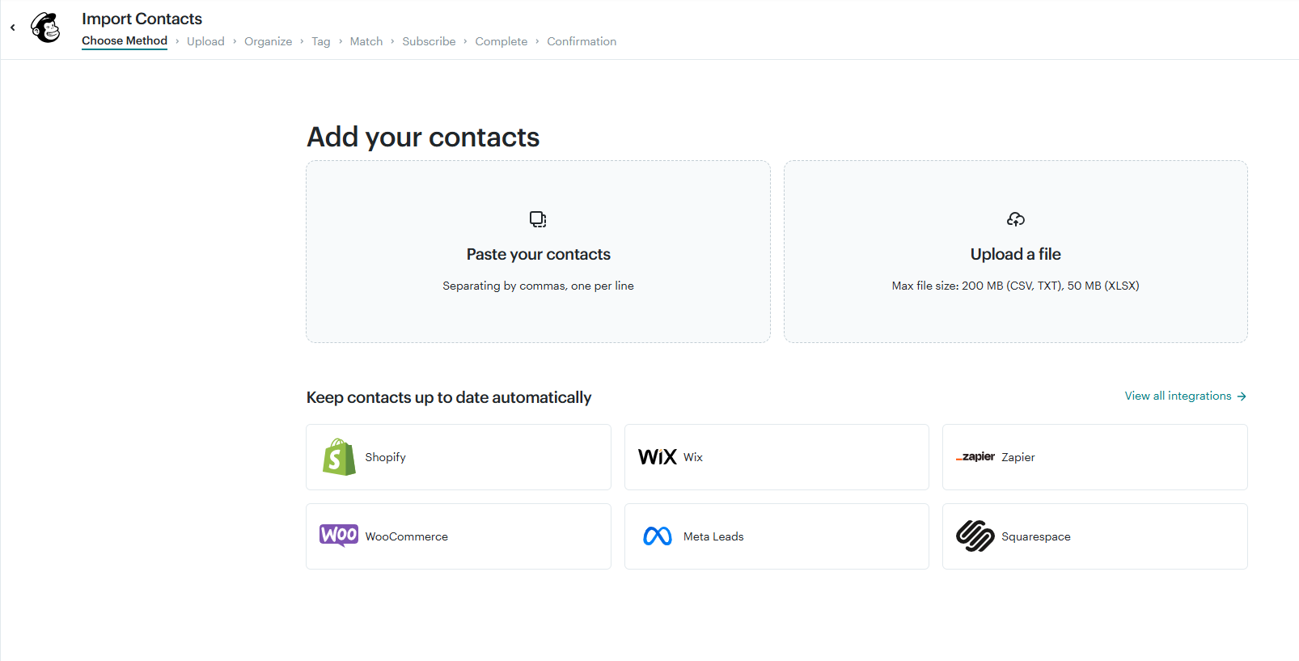
Contact Import Method selection

Slide 12
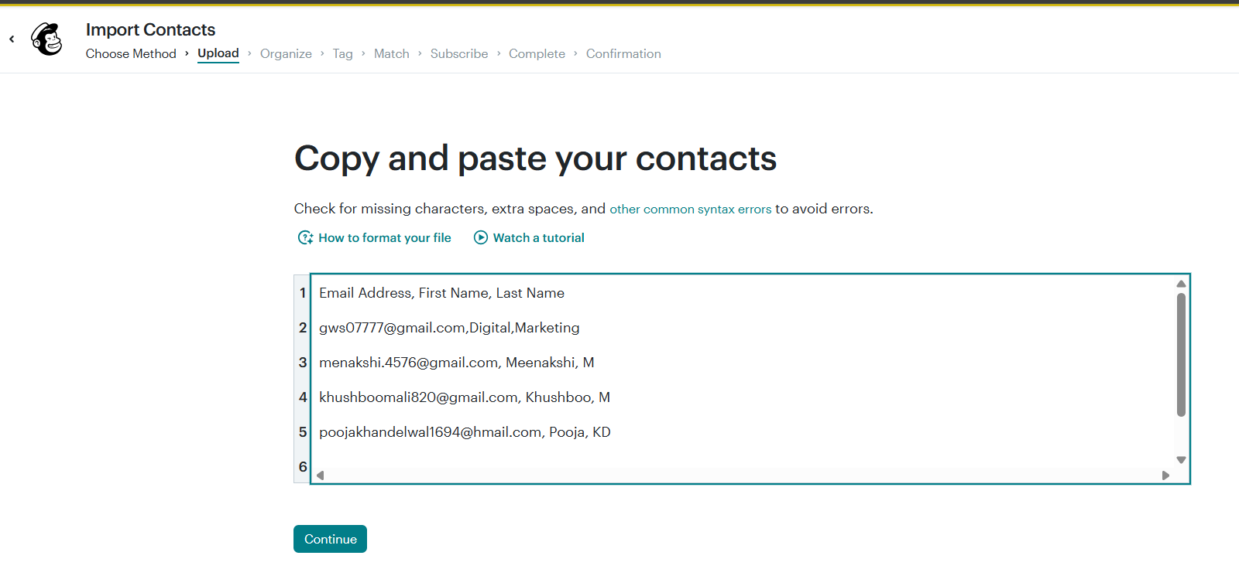
Copy & Paste Your Contacts

Slide 13
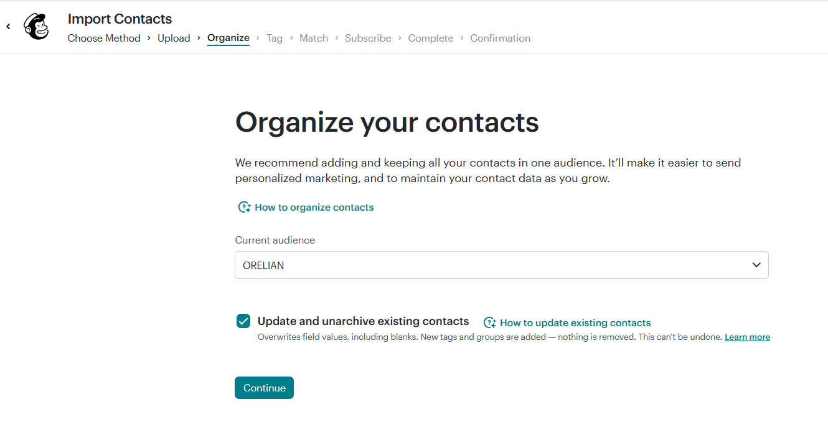
Organize Your Contacts

Slide 14
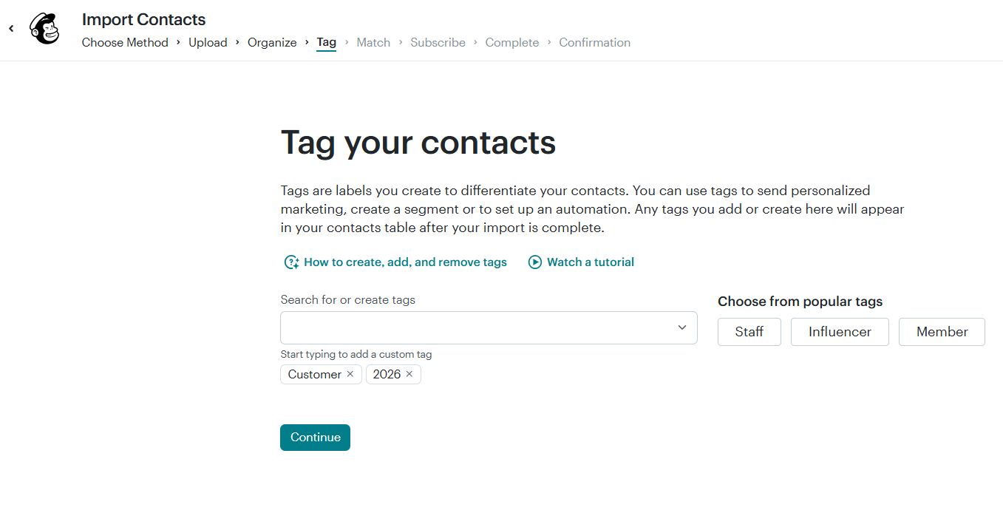
Tag Your Contacts

Slide 15
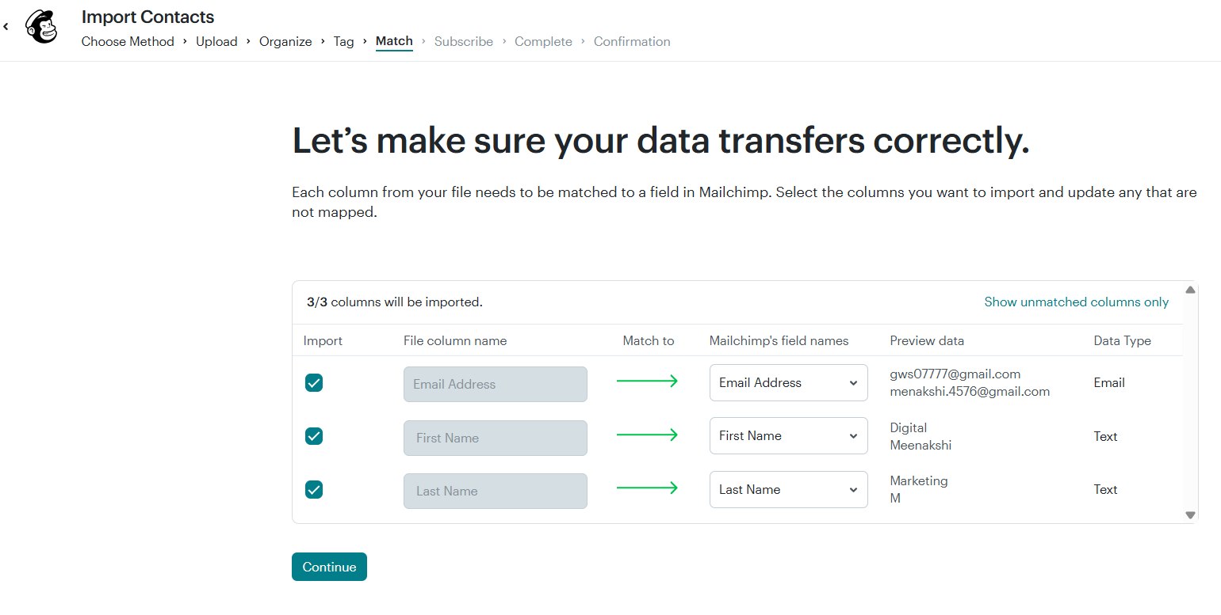
Contact Imported Successfully

Slide 16
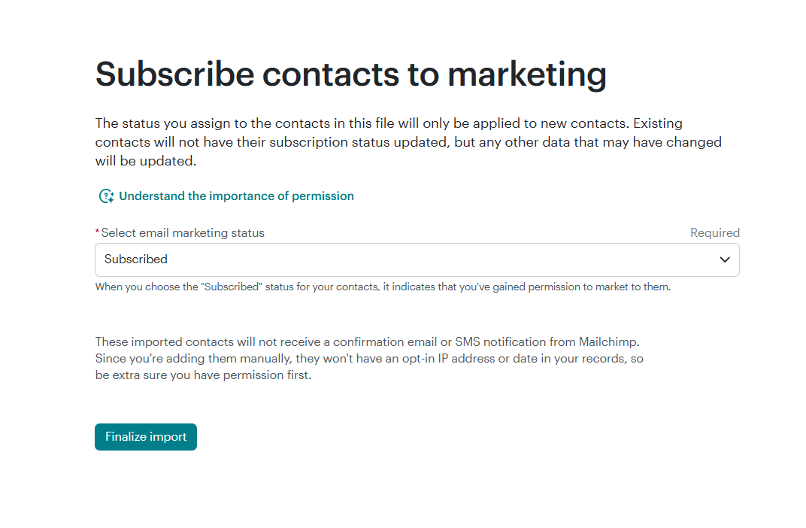
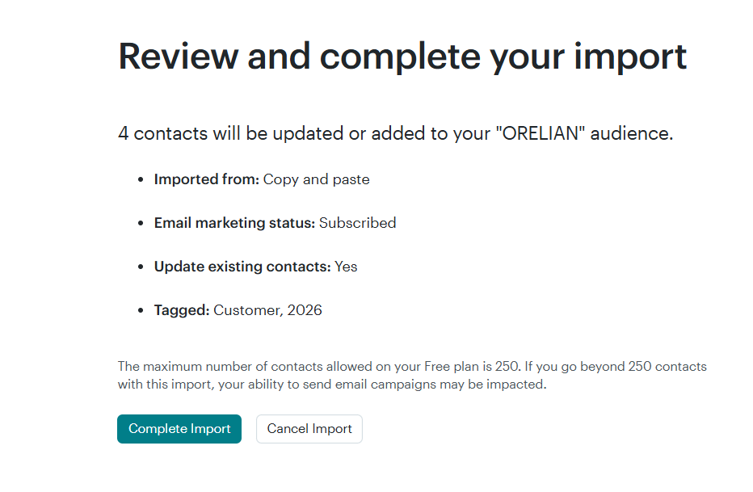
Imported Completion

Slide 17
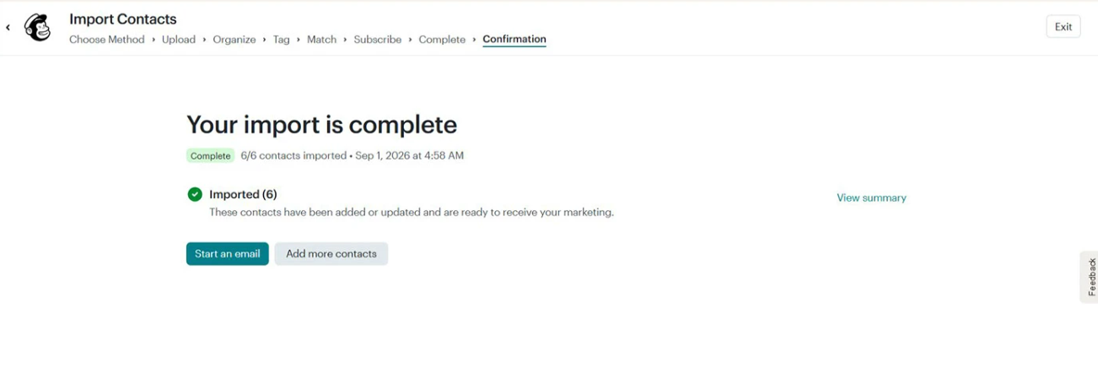
Imported Confirmation

Slide 18
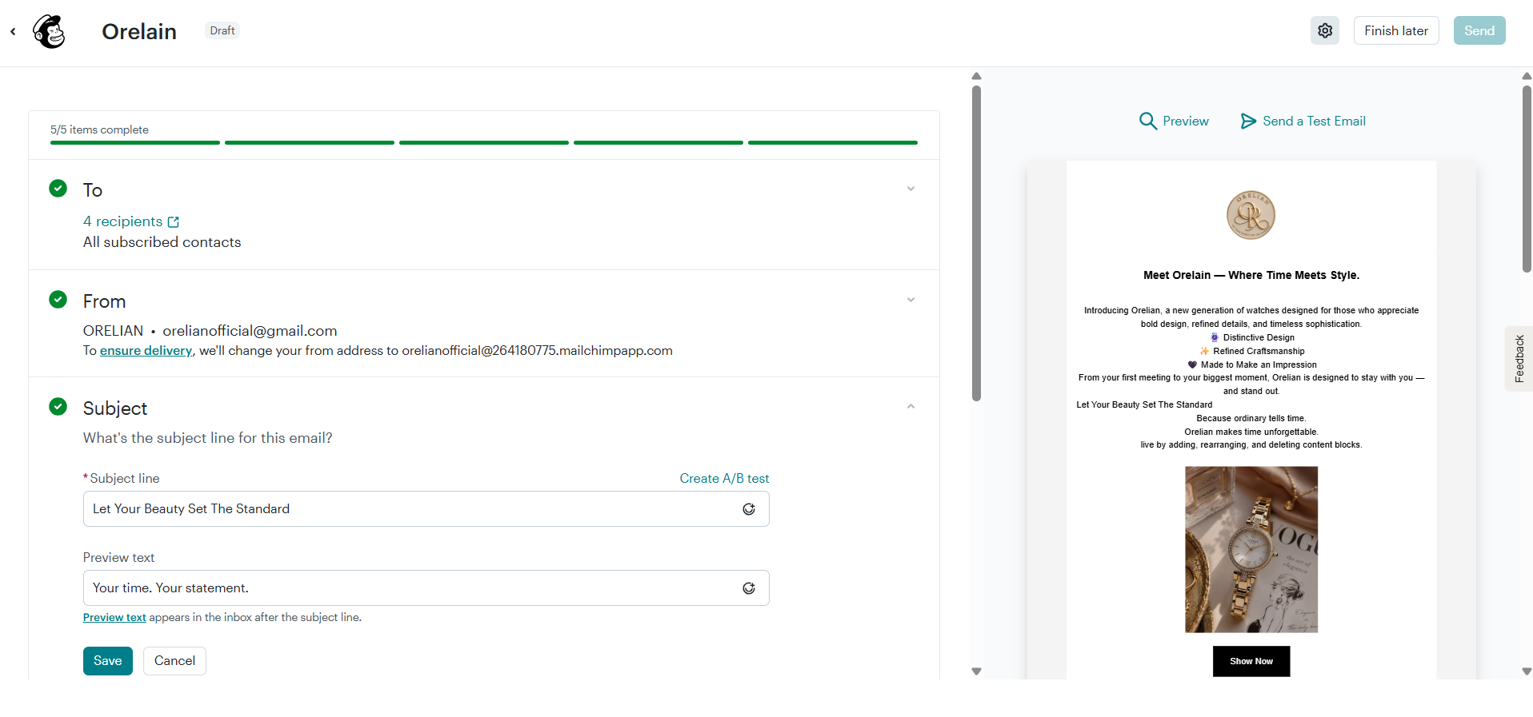
Imported Confirmation
Campaign Preview

Slide 19
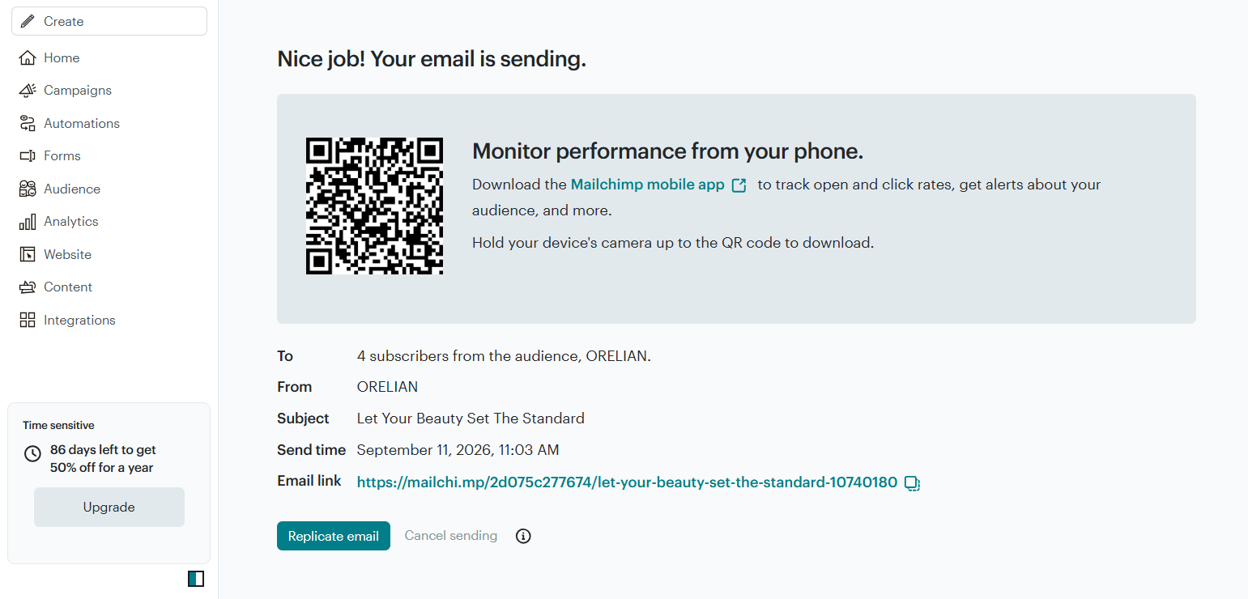
Campaign Successfully Launched

Slide 20
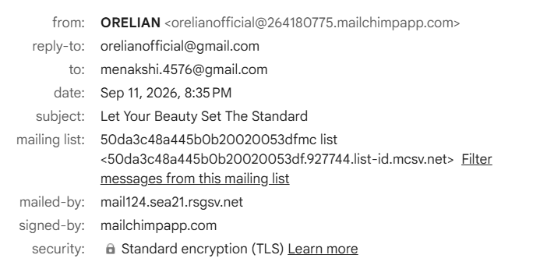
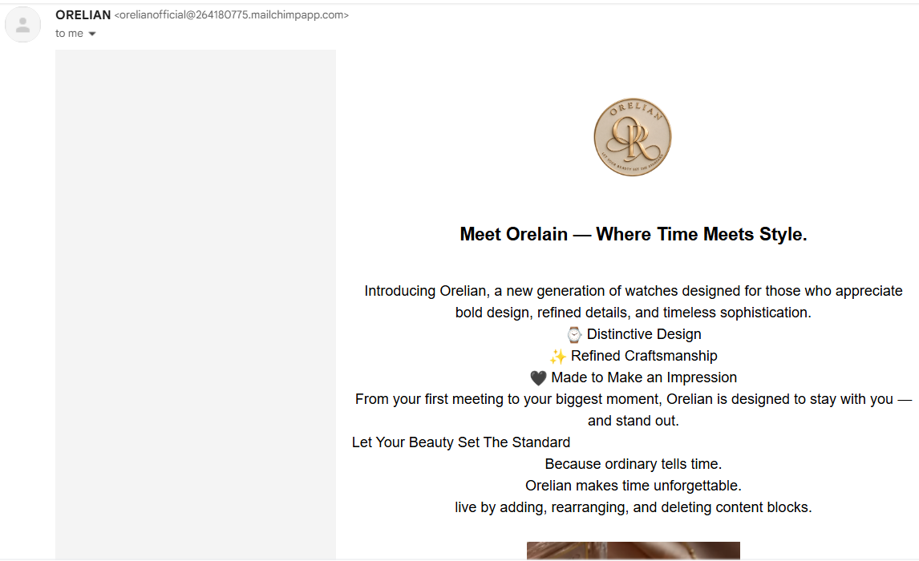
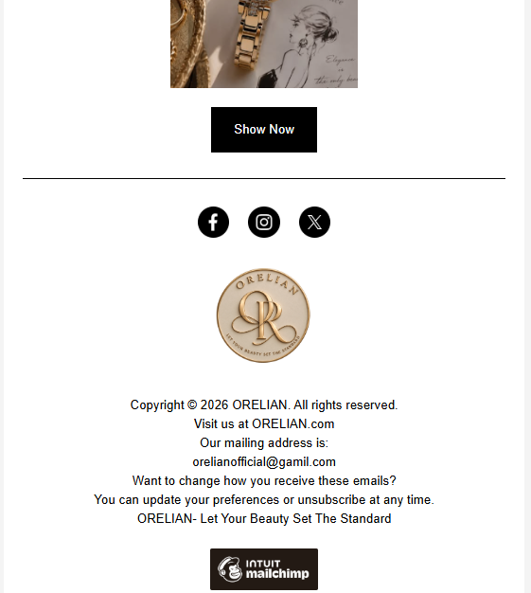
Test Email

Slide 21


